Slide 1
Performance Evaluation of CDL Channel Models in a 5G NR Downlink End-to-End Simulation
Ian Cho ic404
Supervised by: Prof. Albert Guillen I Fabregas, Alexander Hamilton (Nokia)

Slide 2
Objectives and Scope
Construct a 3GPP-compliant simulation framework evaluating different performance metrics, such as throughput and Block Error Rate (BLER), over a range of Signal-to-Noise Ratio (SNR).
Investigate and analyse performance of different Clustered Delay Line (CDL) profiles (CDL-A to E). Each of these profiles model different real-world scenarios for spatial characteristics and delay spreads.
Explore how changes in Multi Input Multi Output (MIMO) configurations (i.e. antenna configuration like no. of layers) and user mobility speeds (Doppler shifts) affect system performance.
Assess the extent to which CDL-defined channel environments influence the practical gains of MIMO by comparing with industry-reported data.

Slide 3
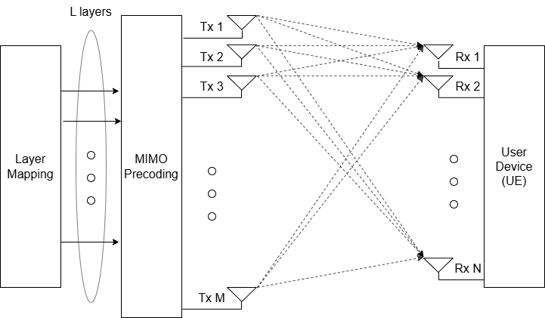
Multiple Input Multiple Output (MIMO)
MIMO makes use of multiple antennas to transmit and receive parallel data streams.
Rank (no. of layers) is determined by min(no. of Tx antennas, no. of Rx antennas)
Codebook-based precoding based on 3GPP-defined codebooks(Type I for SU-MIMO, Type 2 for MU-MIMO)
Each antenna port is mapped onto a resource grid of blocks corresponding to 1 OFDM symbol time and 1 subcarrier frequency
Figure 1: Spatial multiplexing in a Single-User (SU) MIMO system, adapted from (Samsung White Paper, 2020)

Slide 4
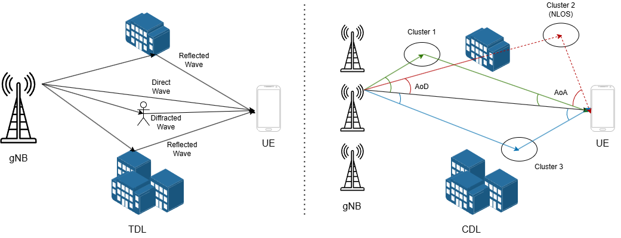
Wireless Channel Modelling
Tapped Delay Line (TDL) – Discrete set of multipath components, known as a ‘tap’, each with fixed delay and fading process in time domain.
Clustered Delay Line (CDL) – Groups of multipath components into clusters, each with defined angular spread and delay. Captures both time and spatial characteristics.
Line of Sight (LOS) vs. None Line of Sight (NLOS) – direct transmission between Rx and Tx vs. reflected, diffracted, and scattered paths.
Currently 3GPP TR 38.901 defines both TDL and CDL models. For Release 19, development of TR 38.753 CDL models.
Figure 2: Illustration of TDL (left) vs. CDL (right) channel model paths, adapted from ShareTechnote and (Ferreira and Vieira, 2021)

Slide 5
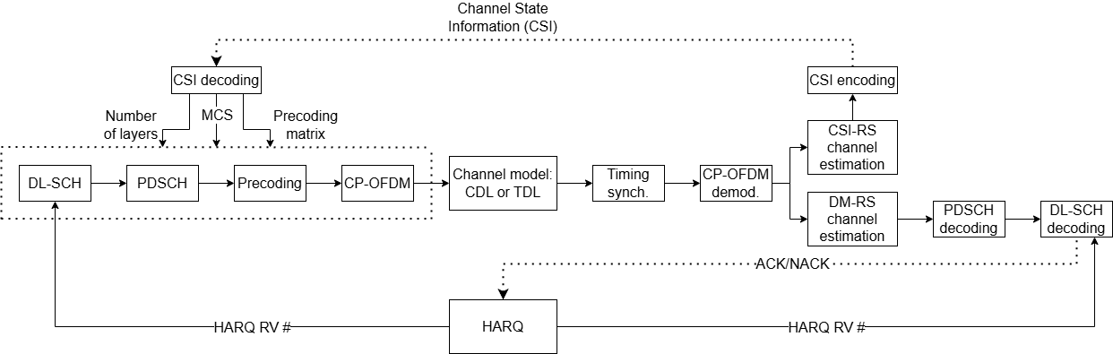
Overview of Simulation Environment and Workflow
MATLAB – 5G Toolbox using 3GPP-defined standardised parameters
Downlink Shared Channel (DL-SCH)
Physical Downlink Shared Channel (PDSCH)
Relative throughput and BLER over a range of SNRs from -5 to 25 dB with 1000 slots per SNR point (Monte Carlo)
8Tx/4Rx 4 layers, 64QAM, 10 Hz Doppler, CDL-C with delay spread 300 ns,
Figure 1: Flow diagram of the implemented end-to-end processing chain for a 5G NR downlink system. Adapted from the MATLAB 5G Toolbox

Slide 6
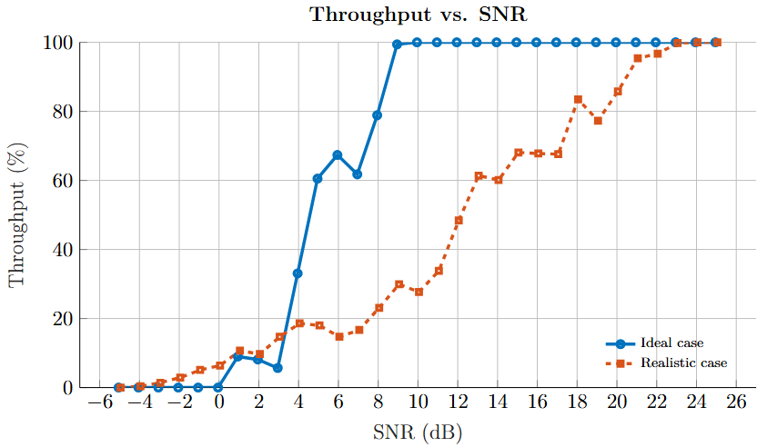
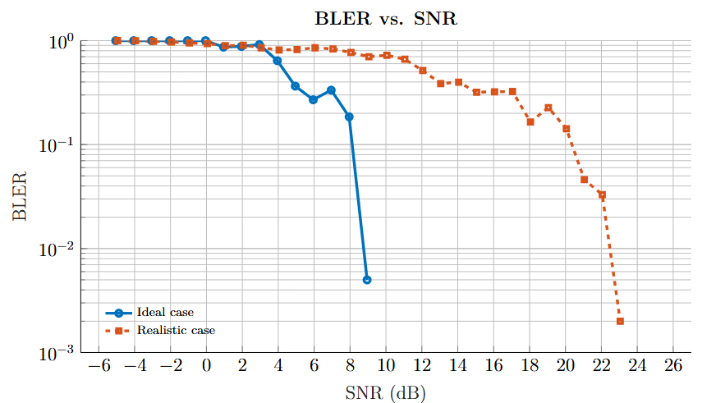
Feature Degradation Under Realistic Assumptions
Figure 2: Throughput and BLER against SNR for ideal and realistic cases

Slide 7
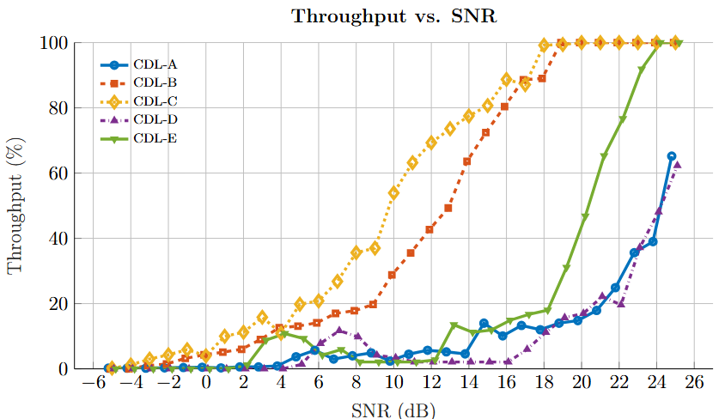
CDL Model Profiles
A delay spread of 300 ns was modelled
CDL-C performs best due to rich angular spread and rich multipath components
CDL-B has narrower angular spread but rich multipaths
CDL-A and CDL-D performs poorly due to long range (250m) from wide angular spread, and inaccurate delay spread.
CDL-E performs better due to stronger LOS, i.e. narrower angular spreads and rich multipaths, but inaccurate delay spread.
Figure 3: Throughput against SNR for different CDL model profiles

Slide 8
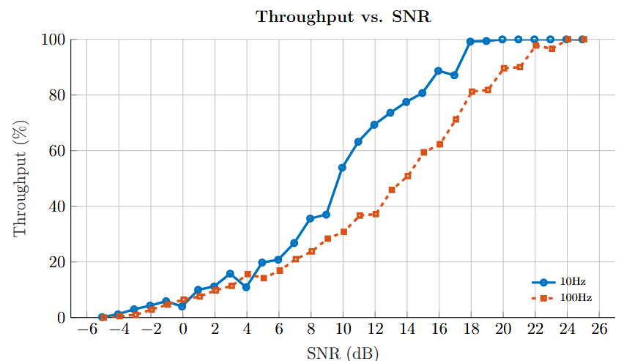
Doppler Shifts
Frequency Range 1 (FR1) 3.5 GHz, 10 Hz and 100 Hz Doppler corresponds to 3 km/h and 30 km/h UE speeds.
This roughly models pedestrian walking and slow urban driving or cycling.
Significant Doppler shifts lead to rapid channel variations, outpacing the channel estimation, increasing decoding errors (Pawase and Chang , 2023)
Around 2 dB and 5 dB performance loss at 30% and 70% throughput between 10 Hz and 100 Hz Doppler
Industry reports state ~0.5 dB performance loss throughout
This is due to poor channel estimation as Least Squares do not consider noise or temporal effects.
Figure 4: Throughput against SNR for different Doppler shifts

Slide 9
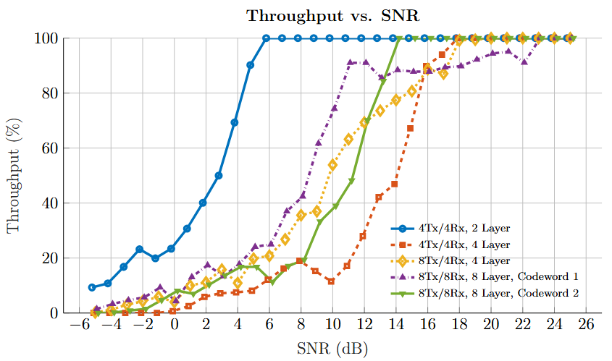
MIMO Configuration
As layers increase, maximum capacity of channel increases and performance over SNRs should increase.
However, the actual channel rank is usually much less than the theoretical maximum.
Hence, there is a bottleneck in performance, especially for the 4Tx/4Rx 4-layer case.
The 8-layer case does not suffer much due to mapping of 2 codewords, effectively reducing the channel rank to 4.
Figure 5: Throughput against SNR for different MIMO configurations

Slide 10
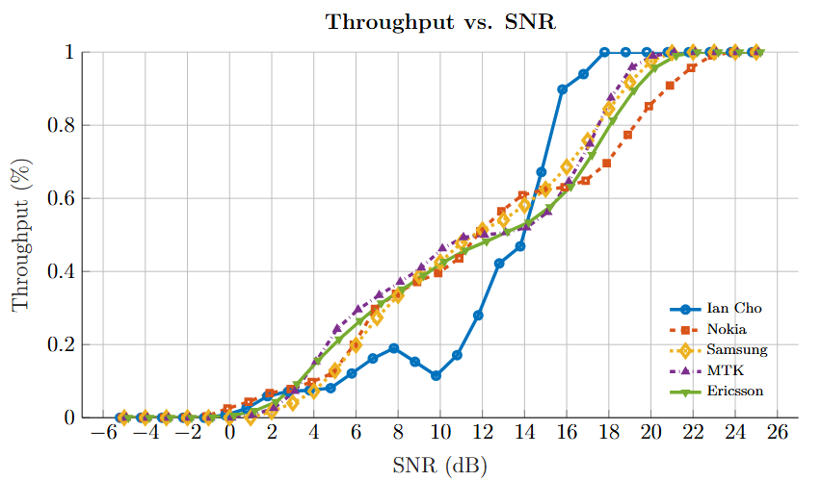
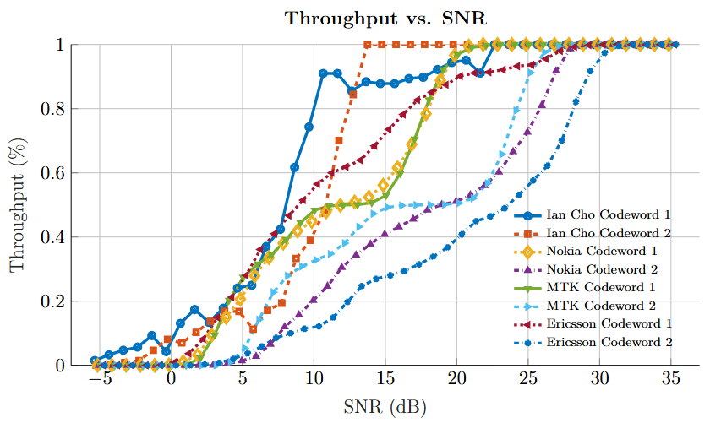
Industry Comparisons
Figure 6: Throughput against SNR for 4-layer and 8-layer case alignment with industry reports

Slide 11
Conclusion and Future work
Contributions
Limitations
Future Work
Developed a 3GPP-compliant MATLAB simulation framework
Systematically compared CDL channel profiles
Explored the impact of MIMO configurations and Doppler shifts
Benchmarked simulation results against industry-reported data
Idealised assumptions – hardware impairments, RF non-linearities, and protocol stack latencies not modelled.
Partial CSI feedback – quantisation and predictive lag simplified. Fixed RI and CQI were used for benchmarking.
Simplified channel estimations
Computational constraints
Focused on downlink only – no uplink or scheduling effects included.
Integration of advanced channel estimation techniques
Expand support for Multi-User MIMO – to reflect more complex scheduling environments
Adaptation of custom CDL profiles

Slide 12
Thank you for listening!

